Slide 1

MultiAgent Chatbot with AG2 for Healthcare
Marcellous Searcy
September 23, 2025
DeVry University and IBM Computers

Slide 2
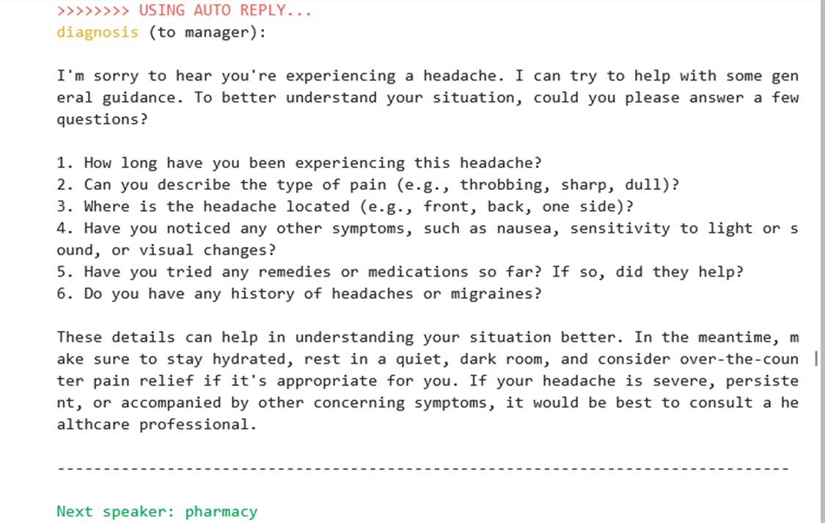
AutoMed multi-agent system
Diagnosis

Slide 3
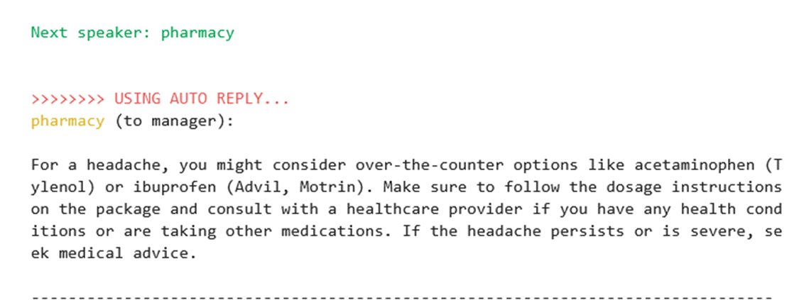
AutoMed multi-agent system Pharmacy

Slide 4
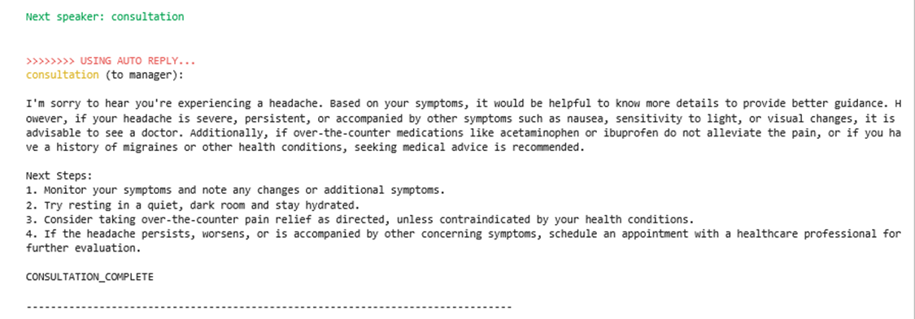
AutoMed multi-agent system Consultation

